Slide 1
Calculation of binomial probability, permutations and combinatiions
Step 1: Start with a dataset contain binary treatment response(‘improvement’ or ‘no improvement’).
Step 2: upload dataset in file widget.
Step 3: calculate probability define this library inside python widget( use library : scipy.stats import binom and FUNCTION:binom.pmf).
Step 4:calculate combination, use library math (math.comb –function) .
Step 5: calculate permutations use function math.perm.

Slide 2
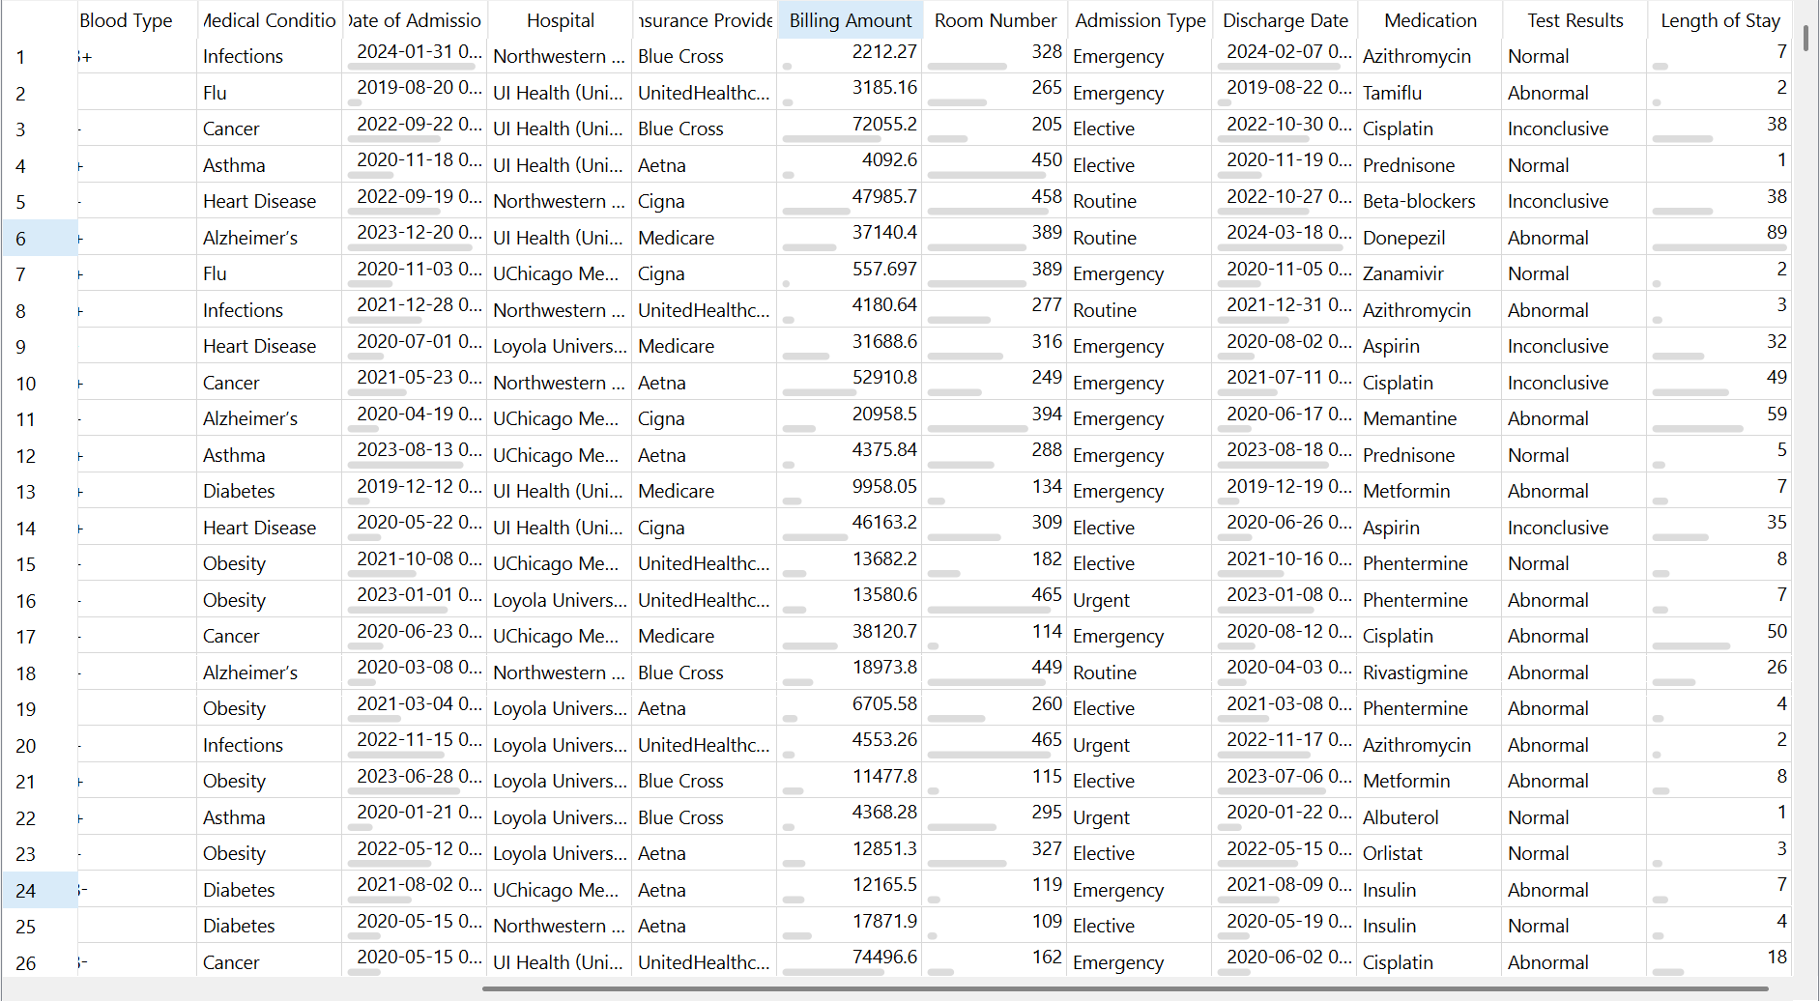

Slide 3
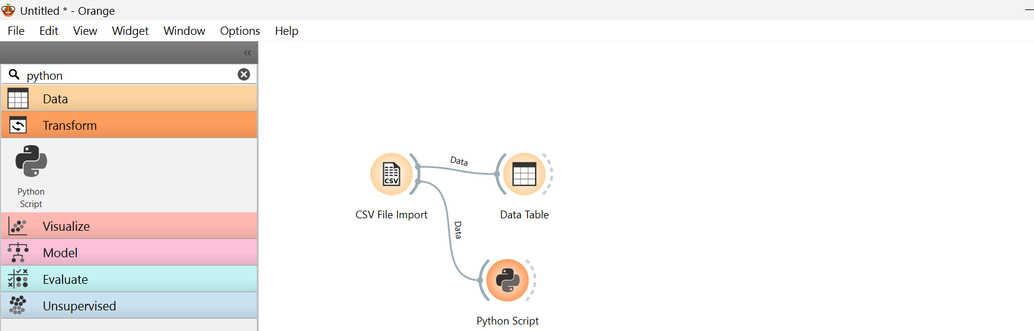

Slide 4
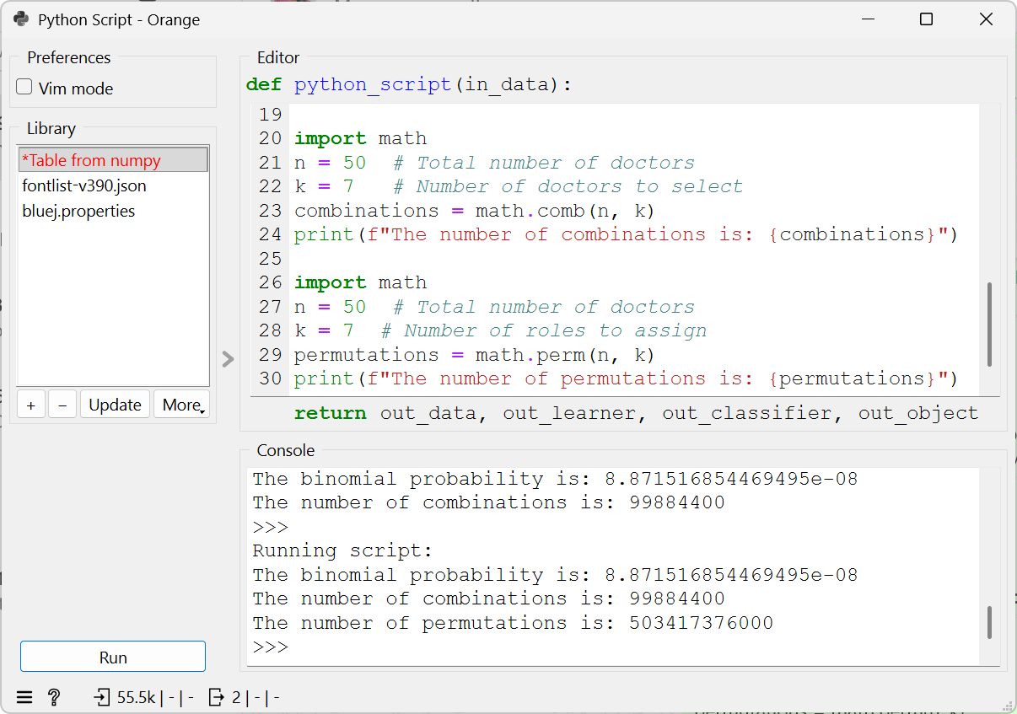

Slide 5
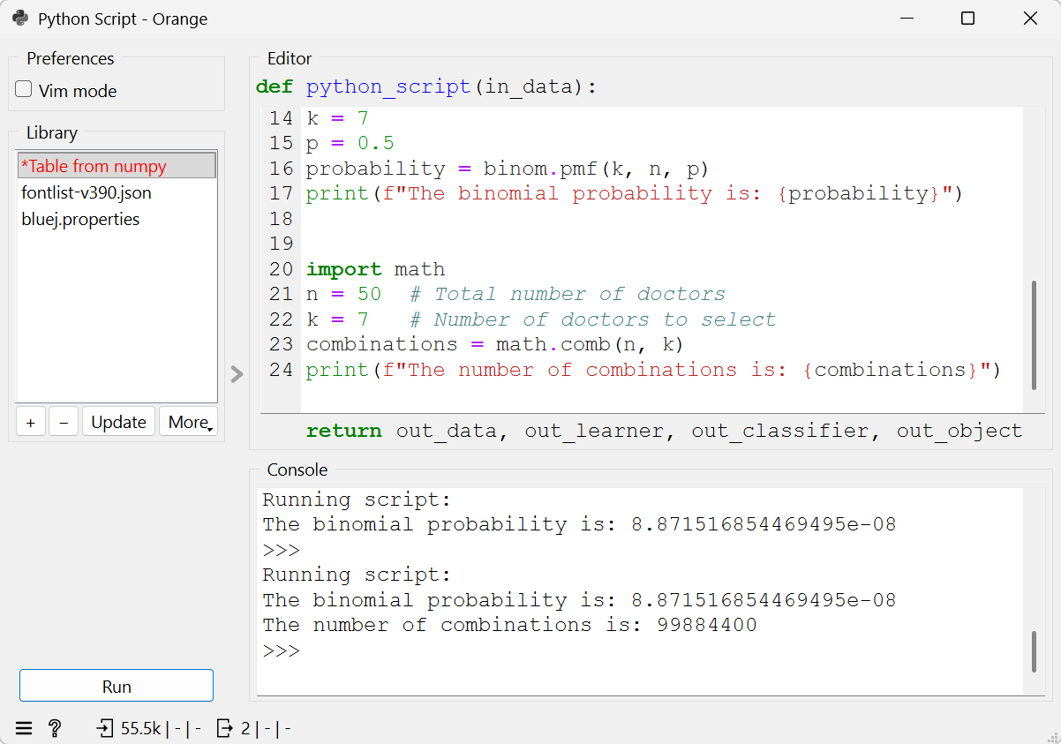
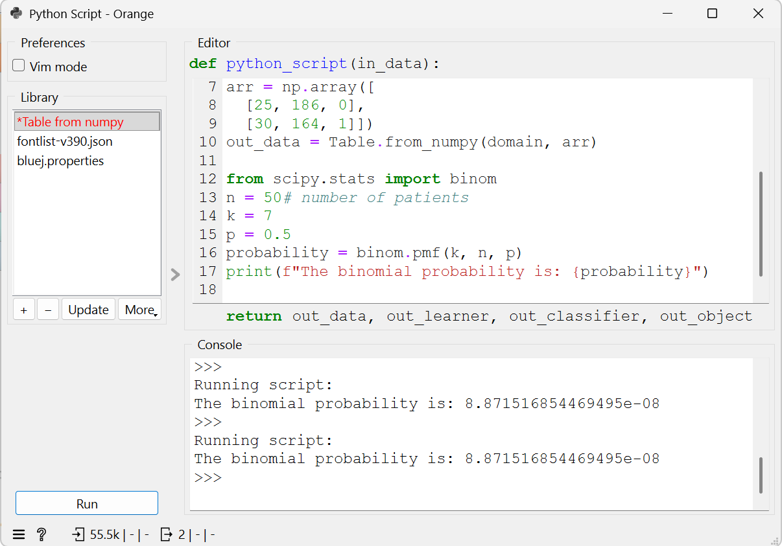
Python codes

